Slide 1
3413ICT Network Security
Lecture 01B
Symmetric Encryption & Confidentiality
Dr V. Muthukkumarasamy
B.Sc.Eng (Hons) (Peradeniya), PhD (Cantab), MIEE, MIEEE

Slide 2
Previous Lecture..
We considered:
Course details, contents, convenor…
Computer, network, internet security definitions
Security services, mechanisms, attacks
Classical cipher techniques and terminology:
Substitution ciphers
Cryptanalysis using letter frequencies
Poly-alphabetic ciphers
Transposition ciphers

Slide 3
Objectives of this lecture..
To understand the operations of modern symmetric ciphers
To study two standards: DES and AES
To study stream ciphers and random number generator

Slide 4
References
Cryptography and Network Security: Principles and Practice, 6th ed., William Stallings, (Chapters 3, 5, and 7)
Applied Cryptography, 2nd ed., Bruce Schneier, (Chapters 3, 11-17)
The Code Breakers, 2nd ed., David Kahn, (Chapter 19)

Slide 5
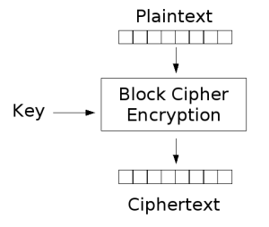
Block Ciphers
One of the most widely used types of ciphers
Provide secrecy as well as authentication services
Encryption standards:
DES (Data Encryption Standard)
AES (Advanced Encryption Standard)
Notes:
Modern block ciphers are widely used to provide encryption of quantities of information, and/or a cryptographic checksum to ensure the contents have not been altered. We continue to use block ciphers because they are comparatively fast, and because we know a fair amount about how to design them. (workshop material)

Slide 6
Block v.s. Stream Ciphers
Block ciphers process messages in blocks, each of which is then en/decrypted
Stream ciphers process messages a bit (or byte) at a time when en/decrypting
Many current ciphers are block ciphers, and broader range of applications
Stream ciphers are usually easy to implement in hardware
Notes:
Block ciphers work a on block / word at a time, which is some number of bits. All of these bits have to be available before the block can be processed. Stream ciphers work on a bit or byte of the message at a time, hence process it as a “stream”. Block ciphers are currently better analysed, and seem to have a broader range of applications, hence focus on them.

Slide 7
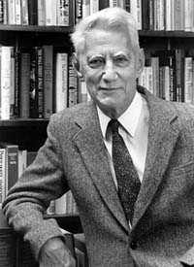
Theory of Claude Shannon
Claude Shannon, known as “the father of information theory”
In 1949, introduced the idea of ciphers based on substitution-permutation (S-P ciphers)
The idea forms the basis of modern block ciphers
S-P cipher is based on the two primitive operations we have seen before:
Substitution (S-box)
Permutation (P-box)
S-P cipher provides confusion & diffusion of message
Claude E. Shannon
(1916-2001)
Notes:
Claude Shannon’s 1949 paper has the key ideas that led to the development of modern block ciphers. Critically, it was the technique of layering groups of S-boxes separated by a larger P-box to form the S-P network, a complex form of a product cipher. He also introduced the ideas of confusion and diffusion, notionally provided by S-boxes and P-boxes (in conjunction with S-boxes).

Slide 8
Confusion and Diffusion
Shannon’s ideas:
Confusion – makes relationship between the ciphertext and key as complex as possible
Diffusion – dissipates statistical structure of plaintext over bulk of ciphertext
Combining S and P elements to obtain confusion and diffusion
Notes:
Every block cipher involves a transformation of a block of plaintext into a block of ciphertext, where the transformation depends on the key. The mechanism of diffusion seeks to make the statistical relationship between the plaintext and ciphertext as complex as possible in order to thwart attempts to deduce the key. confusion seeks to make the relationship between the statistics of the ciphertext and the value of the encryption key as complex as possible, again to thwart attempts to discover the key.
So successful are diffusion and confusion in capturing the essence of the desired attributes of a block cipher that they have become the cornerstone of modern block cipher design.
(exam material)

Slide 9
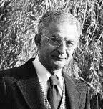
Feistel Cipher
Most symmetric block ciphers use a similar structure as the Feistel Cipher
Devised by Horst Feistel
Block cipher
Block length: 64 bits
It is basically a product cipher,
and implements Shannon’s concept
Encryption / decryption are very efficient
Horst Feistel
(1915 –1990)
Notes:
Most symmetric block encryption algorithms in current use are based on a structure referred to as a Feistel block cipher. A block cipher operates on a plaintext block of n bits to produce a ciphertext block of n bits. An arbitrary reversible substitution cipher for a large block size is not practical, however, from an implementation and performance point of view. In general, for an n-bit general substitution block cipher, the size of the key is n x 2^{n}. For a 64-bit block, which is a desirable length to thwart statistical attacks, the key size is 64 x 2⁶⁴ = 2⁷⁰ = 10²¹ bits. In considering these difficulties, Feistel points out that what is needed is an approximation to the ideal block cipher system for large n, built up out of components that are easily realizable.

Slide 10
Feistel Cipher Structure
Partition data into blocks
Each block has two halves
A substitution on the left half, based on a function of the right half (& a sub-key)
Then have permutation swapping halves
Process data by multiple rounds
Notes:
Horst Feistel, working at IBM Thomas J Watson Research Labs devised a suitable invertible cipher structure in early 70's.
One of Feistel's main contributions was the invention of a suitable structure which adapted Shannon's S-P network in an easily inverted structure. Essentially the same h/w or s/w is used for both encryption and decryption, with just a slight change in how the keys are used. One layer of S-boxes and the following P-box are used to form the round function.
(exam question)

Slide 11
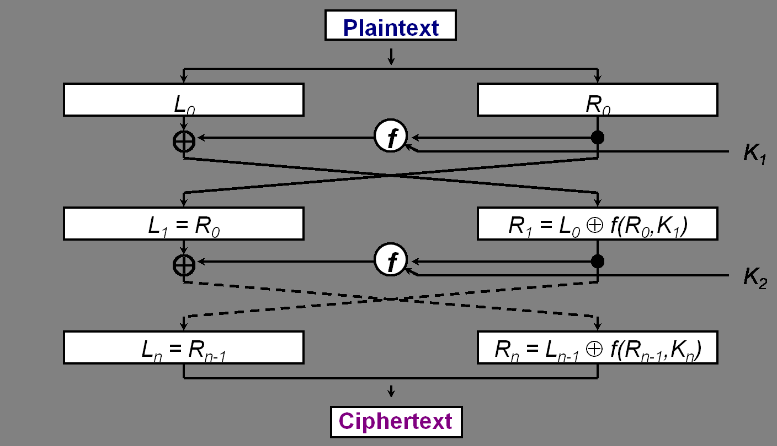
Feistel Cipher Structure
Notes:
(make sure you can draw this for exams)

Slide 12
Feistel Cipher Design Principles
Block size
increasing block size provides greater security, but reduces speed of encryption and decryption
Key size
increasing key size improves security, makes exhaustive key searching harder, but may slow cipher
Number of rounds
increasing number improves security, but makes the cipher less efficient. A typical size is 16 rounds
Sub-key generation
greater complexity can make analysis harder, but slows cipher
Round function
greater complexity can make analysis harder, but slows cipher
Fast software en/decryption and ease of analysis
are more recent concerns for practical use and testing

Slide 13
Data Encryption Standard (DES)
Most widely used encryption standard based block ciphers
Useful in commercial applications
Adopted in 1977 by the NBS (National Bureau of Standard, USA)
now NIST (National Institute of Standards and Technology) after 1988
Encrypts 64-bit data using 56-bit key

Slide 14
DES History
IBM developed a cipher (called Lucifer cipher)
By a team led by Feistel in late 60’s
Encrypting 64-bit data blocks with 128-bit key
Then re-developed as a commercial cipher with input from NSA (National Security Agency) and others, with a reduced key size of 56 bits
In 1973 NBS issued request for proposals for a national cipher standard
IBM submitted their revised version which was eventually accepted as the DES
Notes:
In the late 1960s, IBM set up a research project in computer cryptography led by Horst Feistel. The project concluded in 1971 with the development of the LUCIFER algorithm. LUCIFER is a Feistel block cipher that operates on blocks of 64 bits, using a key size of 128 bits.
Because of the promising results produced by the LUCIFER project, IBM embarked on an effort, headed by Walter Tuchman and Carl Meyer, to develop a marketable commercial encryption product that ideally could be implemented on a single chip. It involved not only IBM researchers but also outside consultants and technical advice from NSA. The outcome of this effort was a refined version of LUCIFER that was more resistant to cryptanalysis but that had a reduced key size of 56 bits, to fit on a single chip.
In 1973, the National Bureau of Standards (NBS) issued a request for proposals for a national cipher standard. IBM submitted the modified LUCIFER. It was by far the best algorithm proposed and was adopted in 1977 as the Data Encryption Standard.

Slide 15
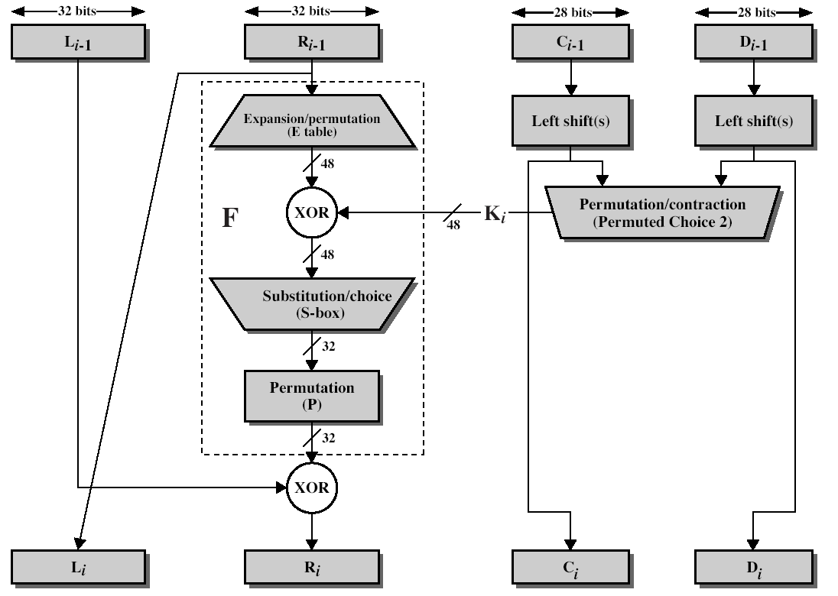
Single Round of DES
(Stallings – Figure 3.6)
Key Schedule
Data

Slide 16
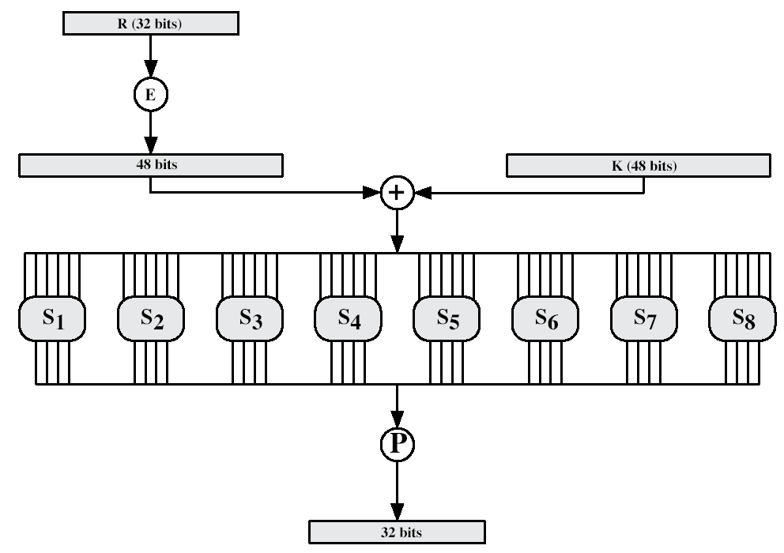
DES Round Structure
(Stallings – Figure 3.7)
Notes:
Stallings Fig 3.9

Slide 17
DES Decryption
With Feistel design, decryption steps will use sub-keys in the reverse order (SK16 … SK1)
The first decryption round undo the 16th encrypt round, using the key SK16
……
The 16th decryption round undo the 1st encrypt round, using SK1

Slide 18
Strength of DES
56-bit keys have 2⁵⁶ = 7.2 x 10¹⁶ values
Brute force search looks hard, but
Recent advances have shown it is possible
As far back as 1977, an attack based on parallel computing was reported (but expensive & time consuming)
In 1998 on dedicated h/w in a few days
In 1999 above combined in 22 hrs!
Still must be able to recognize plaintext
Notes:
DES finally and definitively proved insecure in July 1998, when the Electronic Frontier Foundation (EFF) announced that it had broken a DES encryption using a special-purpose "DES cracker" machine that was built for less than $250,000. The attack took less than three days. The
EFF has published a detailed description of the machine, enabling others to build their own cracker [EFF98].

Slide 19
Origins of AES
Replacement for DES was needed:
have demonstrated exhaustive key search attacks
have theoretical attacks that can break it
Can use Triple-DES – but it is slow
NIST issued call for new ciphers in 1997
15 candidates accepted in Jun 1998
5 were short listed in August 1999
Rijndael was selected as the AES in October 2000
Issued as a standard in November 2001
Notes:
The AES candidates are the latest generation of block ciphers, and now we see a significant increase in the block size - from the old standard of 64-bits up to 128-bits; and keys from 128 to 256-bits. In part this has been driven by the public demonstrations of exhaustive key searches of DES. Whilst triple-DES is regarded as secure and well understood, it is slow, especially in s/w.

Slide 20
AES Requirements
Symmetric key block cipher
128-bit data, 128/192/256-bit keys
Stronger & faster than Triple-DES
Active life of 20-30 years
Provide full specification & design details
Both C & Java implementations
NIST released all submissions for public analyses
Notes:
Need to know key sizes for test

Slide 21
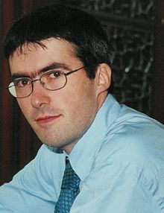
The AES Cipher - Rijndael
Designed by Vincent Rijmen & Joan Daemen from Belgium
128/192/256 bit keys,128 bit data
Designed to be:
Resistant against known attacks
Speed and code compactness on many CPUs
Design simplicity Vincent Rijmen
(born in1970)
Notes:
Rijndael is an academic submission, based on the earlier Square cipher, from Belgium academics Dr Joan Daemen and Dr Vincent Rijmen.
It is an iterative cipher (operates on entire data block in every round) rather than feistel (operate on halves at a time). cf IDEA cipher

Slide 22
Rijndael
Processes data as 4 groups of 4 bytes (states)
Has 9/11/13 rounds in which state undergoes
Byte substitution (1 S-box used on every byte)
Shift rows (permute bytes between groups/columns)
Mix columns (using matrix multiplication)
Add round key (XOR state with key)
All operations can be combined into XOR and table lookups - hence very fast & efficient.
Notes:
Data is written into the state matrix by columns; this matrix is manipulated at stage of the en/decryption process, and is then finally copied to the output.
The key is expanded into 44/52/60 lots of 32-bit words (see later), with 4 used in each round.
The data computation then consists of an “add round key” step, then 9/11/13 rounds with all 4 steps, and a final 10th/12th/14th step of byte subs + mix cols + add round key. All steps are easily reversed.
Note only the “add round key” step makes use of the key and obscures the result, hence MUST be used at start and end of each round, since otherwise could undo effect of other steps. But the other steps provide confusion/diffusion/non-linearity. ie can look at cipher as a series of XOR with key then scramble/permute block repeated. This is efficient and highly secure it is believed.

Slide 23
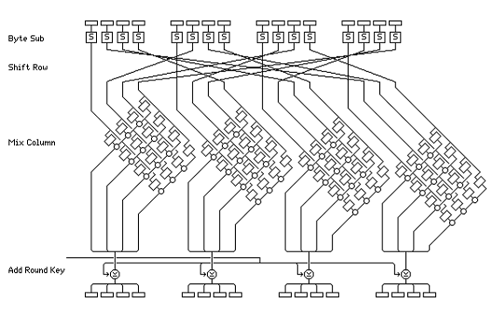
Rijndael Single Round

Slide 24
Implementation Aspects
Can efficiently implement on 8-bit and/or 32-bit CPU
Designers believe the efficient implementation was a key factor in its selection as the AES cipher

Slide 25
Confidentiality by Symmetric Cipher
Symmetric encryption is used to provide message confidentiality
Consider the importance of confidentiality in a typical scenario:
LANs interconnected using switches/routers, with external lines or radio/satellite links
Consider attacks and placement in this scenario:
Snooping from another workstation
Use external router link to enter & snoop
Monitor and/or modify data traffic
Notes:
Have many locations where attacks can occur in typical scenarios.

Slide 26
Confidentiality by Symmetric Cipher
Have two major encryption alternatives:
Link encryption:
Encryption occurs independently on every link
Requires many devices (may cause efficiency issues)
End-to-end encryption:
Encryption occurs between original source and final destination
Need devices at each end with shared keys

Slide 27
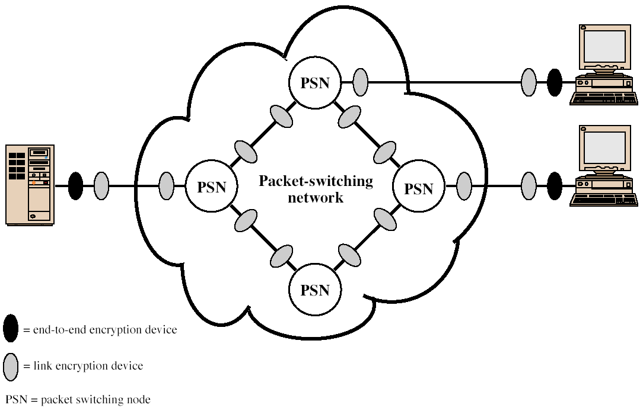
Encryption Across PSN

Slide 28
Traffic Analysis
When using end-to-end encryption, it leaves headers in clear so network can correctly route information
Hence, although contents protected, traffic pattern flows are not
End-to-end encryption protects data contents over entire path and provides authentication
Link encryption also protects traffic flows from monitoring

Slide 29
Key Distribution
Symmetric schemes require both parties to share a common secret key
Issue is how to securely distribute the key
Often secure system failure due to a break in the key distribution scheme
Notes:
This is one of the most critical areas in security systems - on many occasions systems have been broken, not because of a poor encryption algorithm, but because of poor key selection or management. It is absolutely critical to get this right!

Slide 30
Key Distribution
Given parties A and B, have various key distribution alternatives
A can select key and physically deliver to B
3rd party can select & deliver key to A & B
If A & B have communicated previously can use previous key to encrypt/decrypt a new key
If A & B have secure communications with a third party C, C can relay key between A & B
Notes:
Physical delivery (1 & 2) is simplest - but only applicable when there is personal contact between recipient and key issuer. Is fine for link encryption where devices & keys occur in pairs, but does not scale as number of parties who wish to communicate grows.
A third party is a trusted intermediary, whom all parties trust, to mediate the establishment of secure communications between them. Must trust intermediary not to abuse the knowledge of all session keys.
As number of parties grow, some variant of 4 is only practical solution.

Slide 31
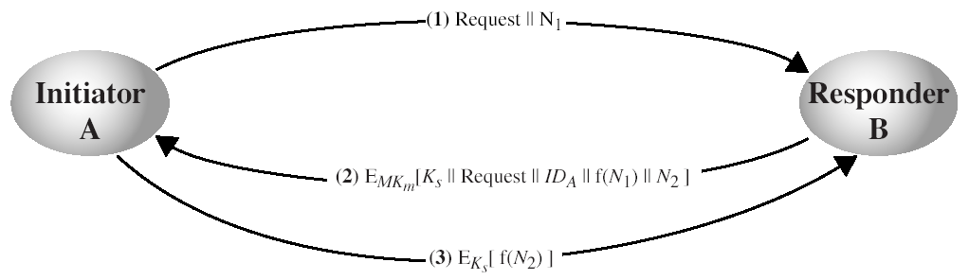
Decentralized Key Distribution
No need of having a trusted KDC
How many keys are required for a system of n users?
Notes:
N = nons (random number that has been generated to sequencing)

Slide 32
Decentralized Key Distribution
No need of having a trusted KDC
How many keys are required for a system of n users?
Answer: n(n-1)/2

Slide 33
Key Hierarchy
A KDC (key distribution center) for large networks, but must trust each other
Typically have a hierarchy of keys
Session key
temporary key
used for encryption of data between users
for one logical session then discarded
Master key
used to encrypt session keys
shared by user & KDC
Notes:
The use of a key distribution center is based on the use of a hierarchy of keys. At a minimum, two levels of keys are used: a session key, used for the duration of a logical connection; and a master key shared by the key distribution center and an end system or user and used to encrypt the session key.

Slide 34
Stream Ciphers
Process message bit by bit (as a stream)
Have a random (or pseudo random) keystream
Combined (XOR) with plaintext bit by bit
Encryption / Decryption:
Notes:
Getting good random numbers is important, but difficult. You don't want someone guessing the key you're using to protect your communications because your "random numbers" weren't (as happened in an early release of Netscape SSL).
Although have well-defined tests for determining that a sequence of numbers match uniform distribution, there is no such test to "prove“ independence. Rather, use a number of tests to demonstrate that a sequence does not
exhibit independence, until the confidence that independence exists is sufficiently strong.
Since often use pseudo-random number, must ensure cannot predict future elements of sequence on basis of
earlier elements.

Slide 35
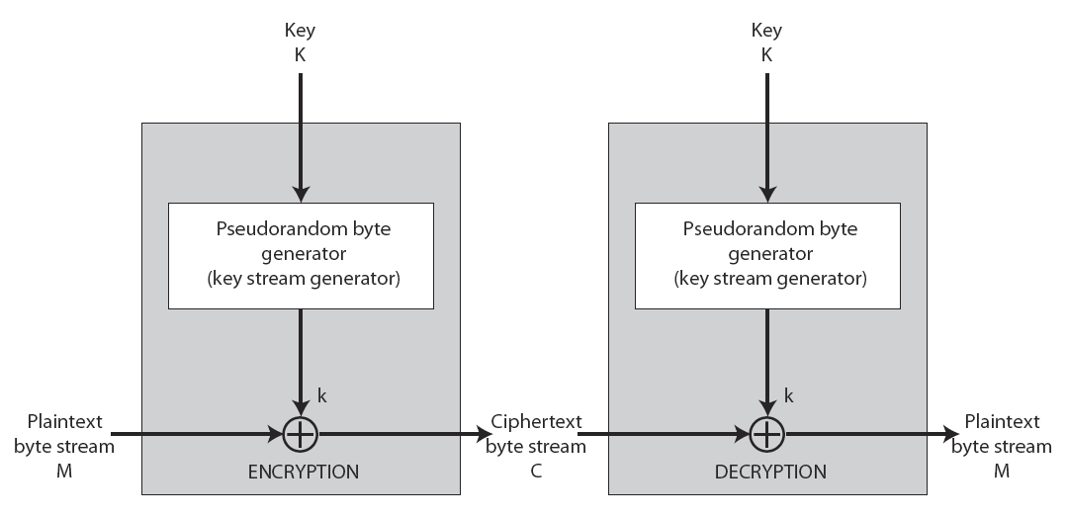
Stream Cipher Structure
Notes:
Getting good random numbers is important, but difficult. You don't want someone guessing the key you're using to protect your communications because your "random numbers" weren't (as happened in an early release of Netscape SSL).
Although have well-defined tests for determining that a sequence of numbers match uniform distribution, there is no such test to "prove“ independence. Rather, use a number of tests to demonstrate that a sequence does not
exhibit independence, until the confidence that independence exists is sufficiently strong.
Since often use pseudo-random number, must ensure cannot predict future elements of sequence on basis of
earlier elements.
(Make sure you can draw this)

Slide 36
An Example of Stream Cipher
LFSR

Slide 37
Linear Feedback Shift Register (LFSR)
Feedback polynomial:

Slide 38
Random Numbers
Many uses of random numbers in cryptography:
Generating session keys
Public key generation
Keystream for a stream cipher
In all cases it is critical that these values be
Statistically random with
Uniform distribution
Independence
Unpredictable: cannot infer future sequence on previous values
Notes:
Getting good random numbers is important, but difficult. You don't want someone guessing the key you're using to protect your communications because your "random numbers" weren't (as happened in an early release of Netscape SSL).
Although have well-defined tests for determining that a sequence of numbers match uniform distribution, there is no such test to "prove“ independence. Rather, use a number of tests to demonstrate that a sequence does not
exhibit independence, until the confidence that independence exists is sufficiently strong.
Since often use pseudo-random number, must ensure cannot predict future elements of sequence on basis of
earlier elements.

Slide 39
Published Sources
Some published collections of random numbers:
Rand Co, in 1955, published 1 million numbers generated using an electronic roulette wheel
Earlier Tippett published a collection in 1927
Issues are that:
These are limited
Too well-known for most uses

Slide 40
Pseudorandom Number Generators (PRNGs)
One can use algorithms to create “random numbers”:
They are “almost random”, but
Not truly random
Called “pseudorandom numbers”
An implementation of such an algorithm is called a pseudorandom number generator (PRNG) – for example, a LFSR

Slide 41
Summary
We have studied:
Block ciphers vs stream ciphers
DES & AES
Using symmetric encryption to protect confidentiality
Key distribution
Stream ciphers
Random number generation

Slide 42
Next Lecture…
Public Key Cryptography & Authentication…

Slide 43

Questions?

